Slide 1

IBM Data Analyst
Capstone Project
Sidharth Zambre

Slide 2

OUTLINE
Executive Summary
Introduction
Methodology
Results
Visualization – Charts
Dashboard
Discussion
Findings & Implications
Conclusion

Slide 3

EXECUTIVE SUMMARY
JavaScript, Python, HTML/CSS, SQL, and TypeScript are the most desirable programming languages for next year.
PostgreSQL, MongoDB, Redis, MySQL, and ElasticSearch are the most desirable databases for next year.
Gender gap in the IT industry.
Male = 93.7%
Female = 6.3%

Slide 4

INTRODUCTION
Stack Overflow, a popular website for developers, conducted a survey amongst developers from around the world about technology trends in 2019.
Programming Languages
Databases
Demographics
Target audience:
IT professionals
Anyone interested in the IT field

Slide 5

METHODOLOGY
Data Sources:
Stack Overflow Developers Survey 2019
Github Job Posting
Programming Language Annual Salary
Data Exploration and Cleaning
Python
Data Visualization
IBM Cognos Analytics
Presentation

Slide 6
RESULTS

Slide 7
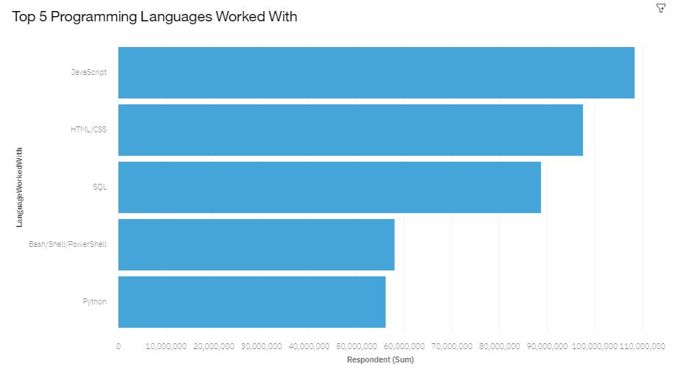
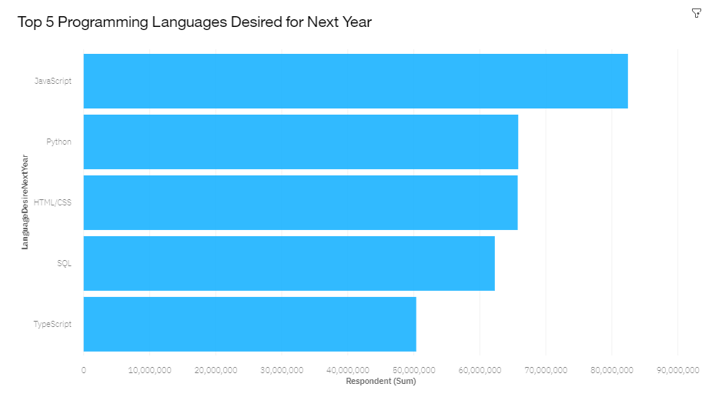
PROGRAMMING LANGUAGE TRENDS

Slide 8



PROGRAMMING LANGUAGE TRENDS –
FINDINGS & IMPLICATIONS
Findings Implications
JavaScript is the most in demand programming language.
Python, HTML/CSS, and SQL are other in demand programming languages.
Skills in TypeScript is more desirable than Bash/Shell/PowerShell for next year.
Python’s increase in demand may overtake JavaScript in the future.
JavaScript, Python, HTML/CSS, and SQL are consistently in demand.
Web development remains in high demand.

Slide 9
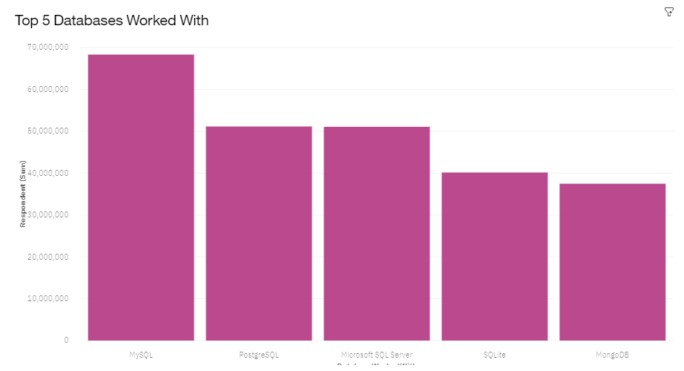
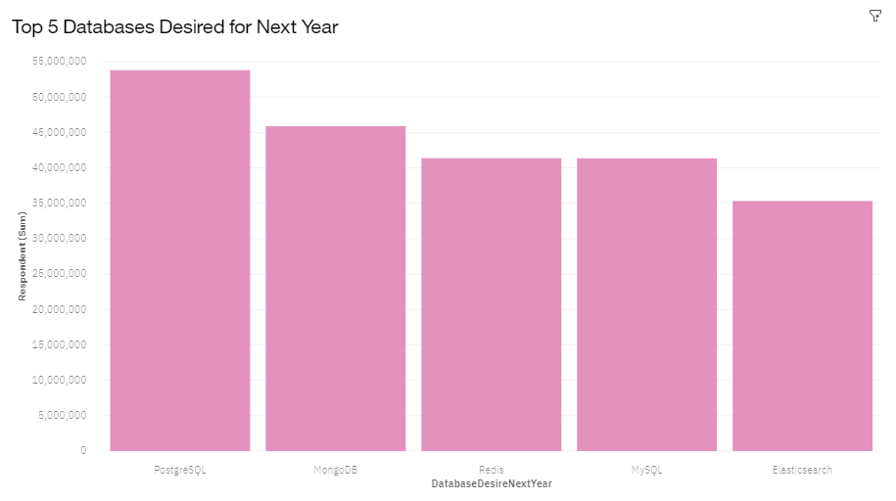
DATABASE TRENDS

Slide 10
DATABASE TRENDS – FINDINGS & IMPLICATIONS
Findings
PostgreSQL and MongoDB have an increase in demand.
MySQL has a decrease in demand for next year.
Skills in Redis and ElasticSearch are more desirable than Microsoft SQL Server and SQLite for next year.
Implications
PostgreSQL and MongoDB are the most consistent in demand databases.
Open source databases are preferred.
Demand is volatile.

Slide 11
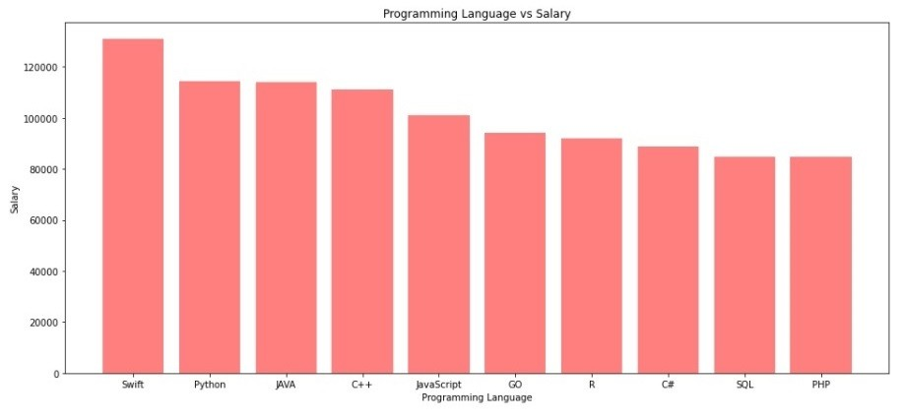
GITHUB JOB POSTINGS

Slide 12
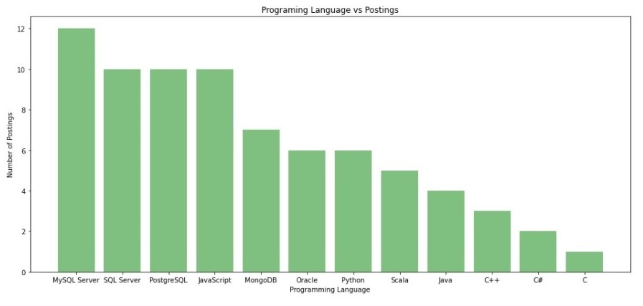
POPULAR LANGUAGES

Slide 13

DASHBOARD
<https://dataplatform.cloud.ibm.com/dashboards/ f0081943-1354-4668-ae48-29245ab2d0f5/view/
5460d50564962be150d0b1e407cf2a527e652c54babb8b0b87d17b
490a602497a83b1196c8284c58da14066bfbe9405ec1>

Slide 14
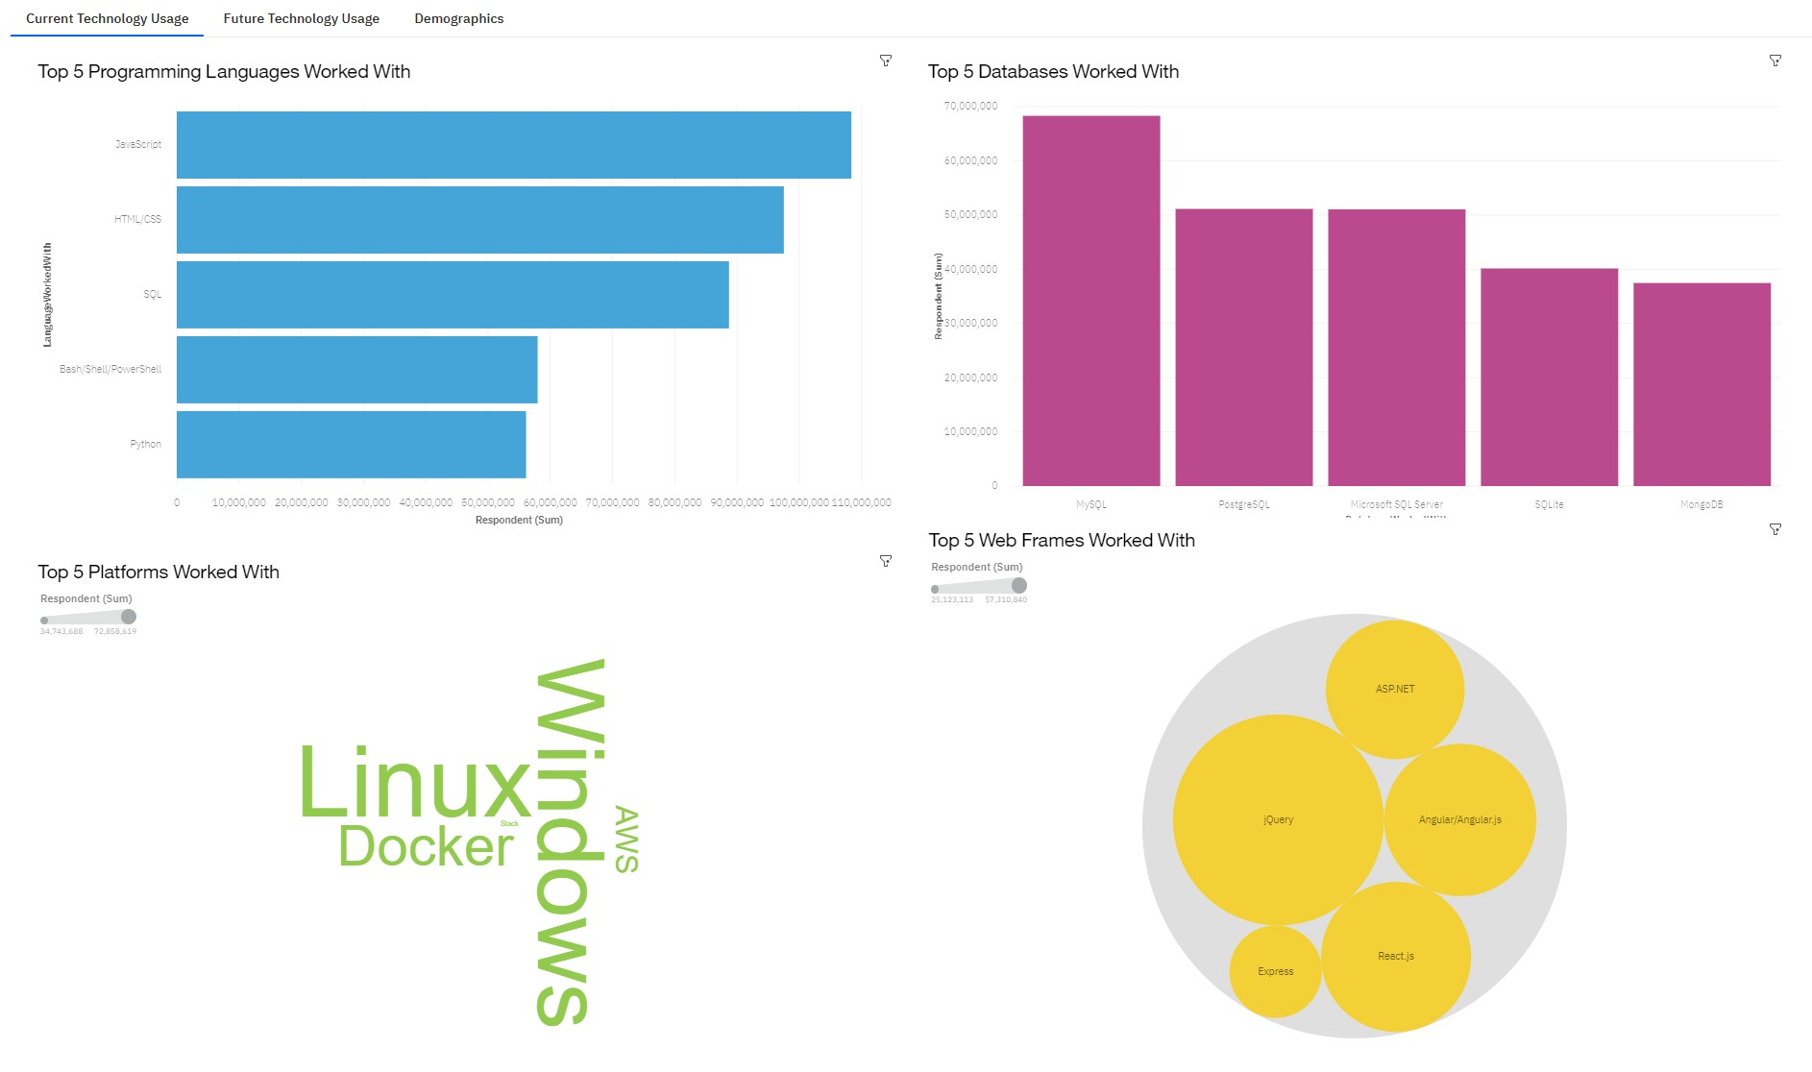
DASHBOARD TAB 1

Slide 15
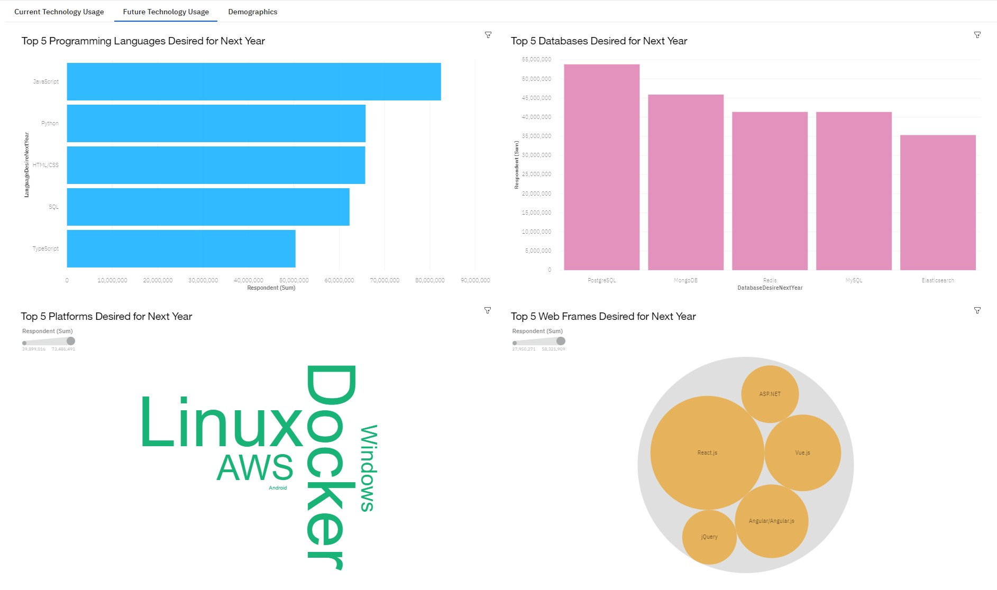
DASHBOARD TAB 2

Slide 16
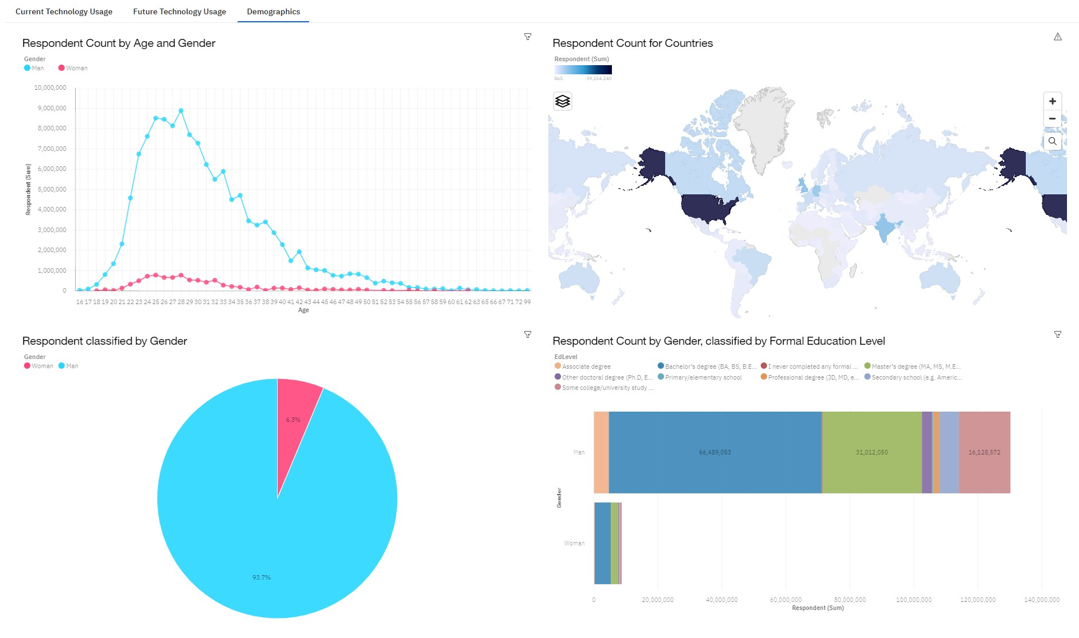
DASHBOARD TAB 3

Slide 17
DISCUSSION
New technology constantly emerges leading to changes in demand.
The IT industry needs to diversify in order to eliminate gender gap.

Slide 18
OVERALL FINDINGS & IMPLICATIONS
Findings Implications
Trends and demands fluctuate based on new technologies.
JavaScript and Python are the most popular programming languages.
PostgreSQL is the most popular database.
Gender gap in the IT field.
IT professionals and companies have to learn and adapt to new demands.
Having skills that are high in demand leads to more job opportunities.
Gender gap will affect job hiring trend.

Slide 19

CONCLUSION
New technology leads to different trends and demands.
JavaScript and Python are the most popular programming languages.
PostgreSQL is the most popular database.
The IT industry needs to diversify.

